Slide 1
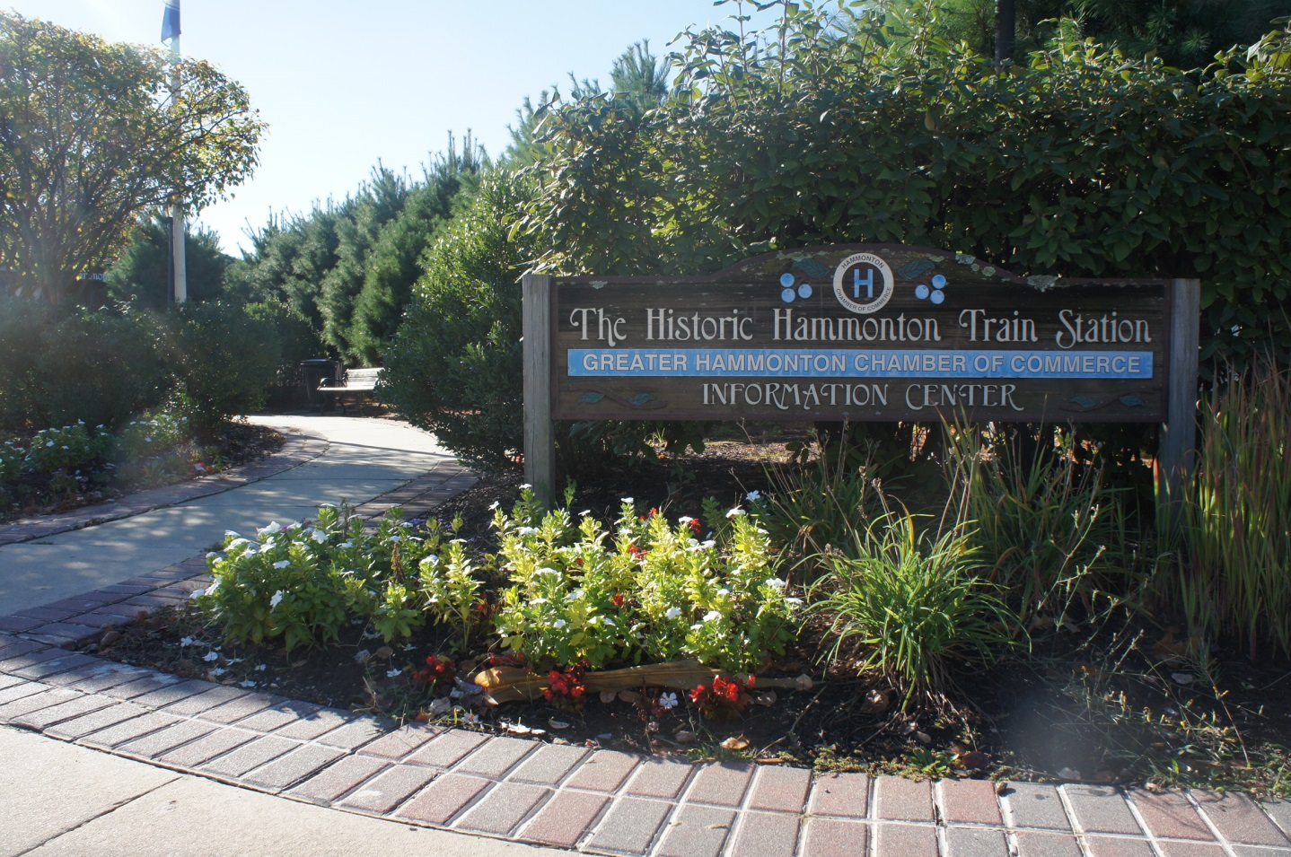
Storytelling of Hammonton

Slide 2
Walking to downtown Hammonton from my school has some historical sites such as the Town Hall and the clock.

Slide 3
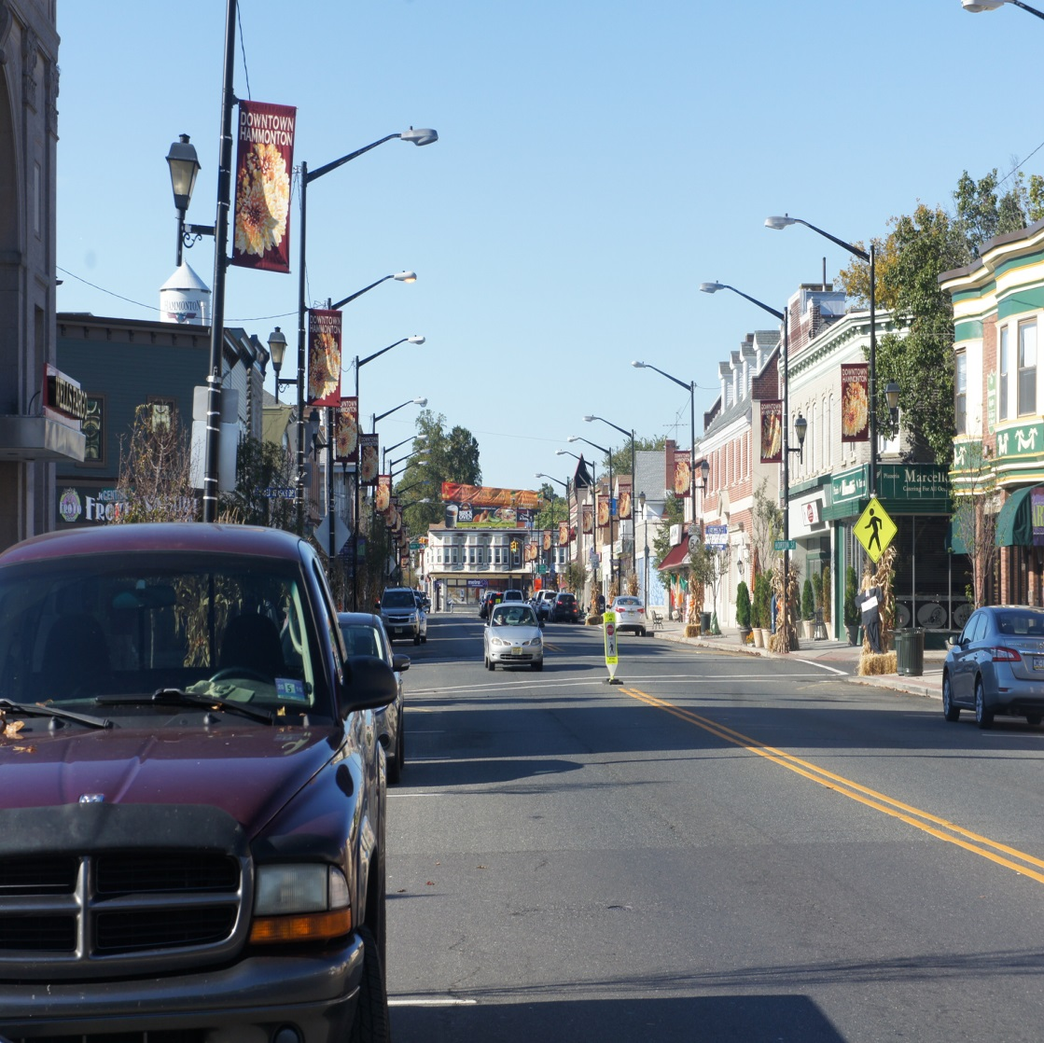
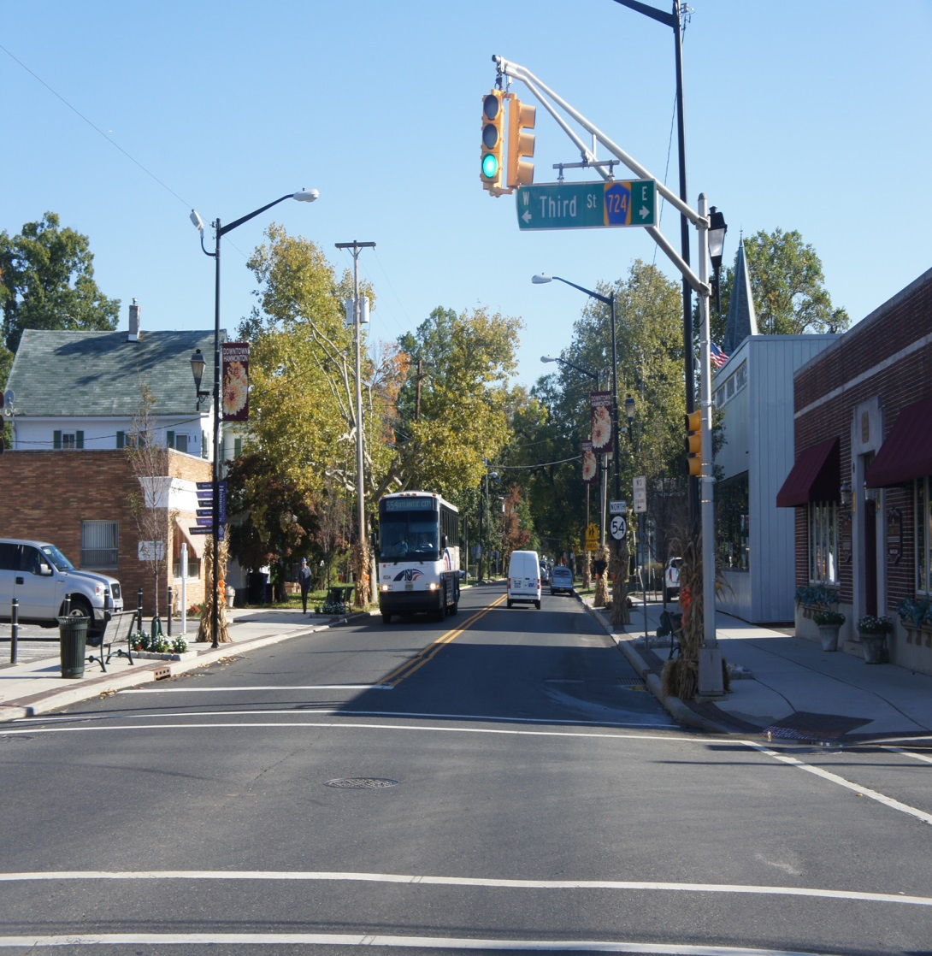
Leads to route 54
Leads to the White Horse Pike
The Main street in Down town Hammonton is Bellevue which stretches from route 54 to the White Horse Pike.

Slide 4
This historical stone is in memorial of when Ronald Reagan came to Hammonton. He gave us this monument to show how important this town really is.

Slide 5
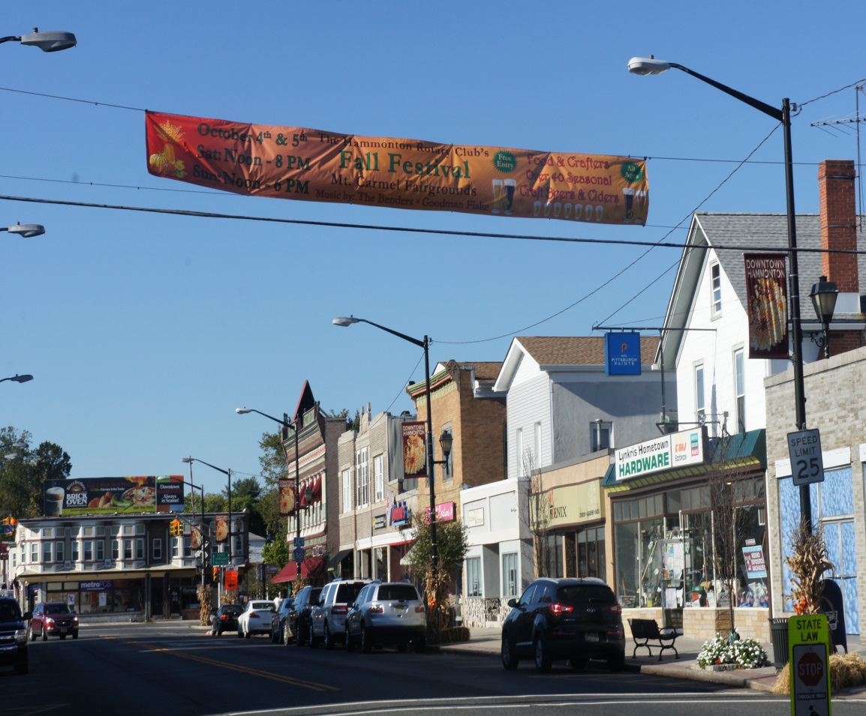
Hammonton is filled with town events such as the fall festival, car shows, carnivals, and Christmas season. The picture on the right shows the tree that gets decorated every Christmas.

Slide 6
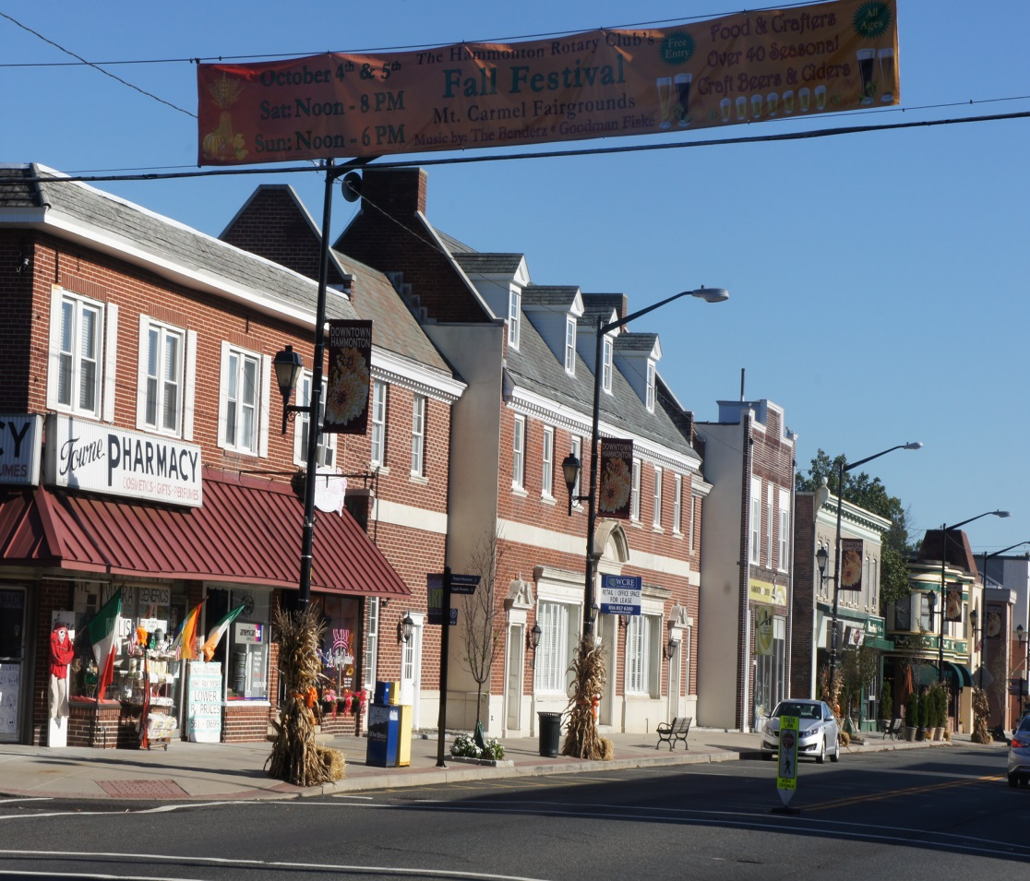
On Bellevue there are many shops and stores. After school I like to shop or go out to eat. But most the time I’ll just walk around.

Slide 7
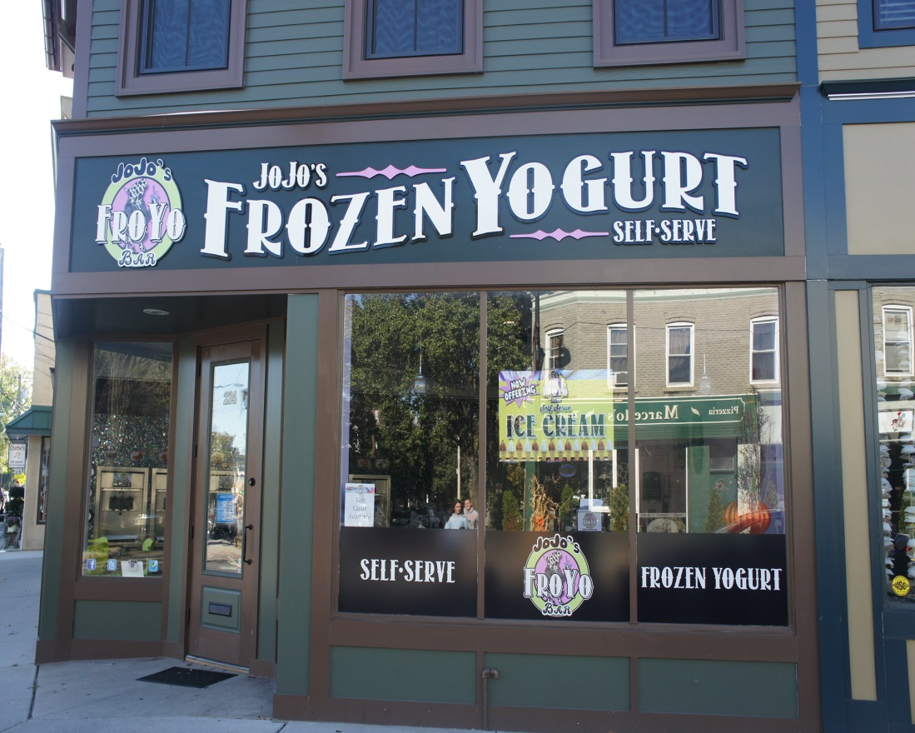
These are my favorite places to eat. I go to Marcello's a lot for lunch and if I am still hungry, Ill just walk across the street to JoJo’s for some Fro-yo.

Slide 8
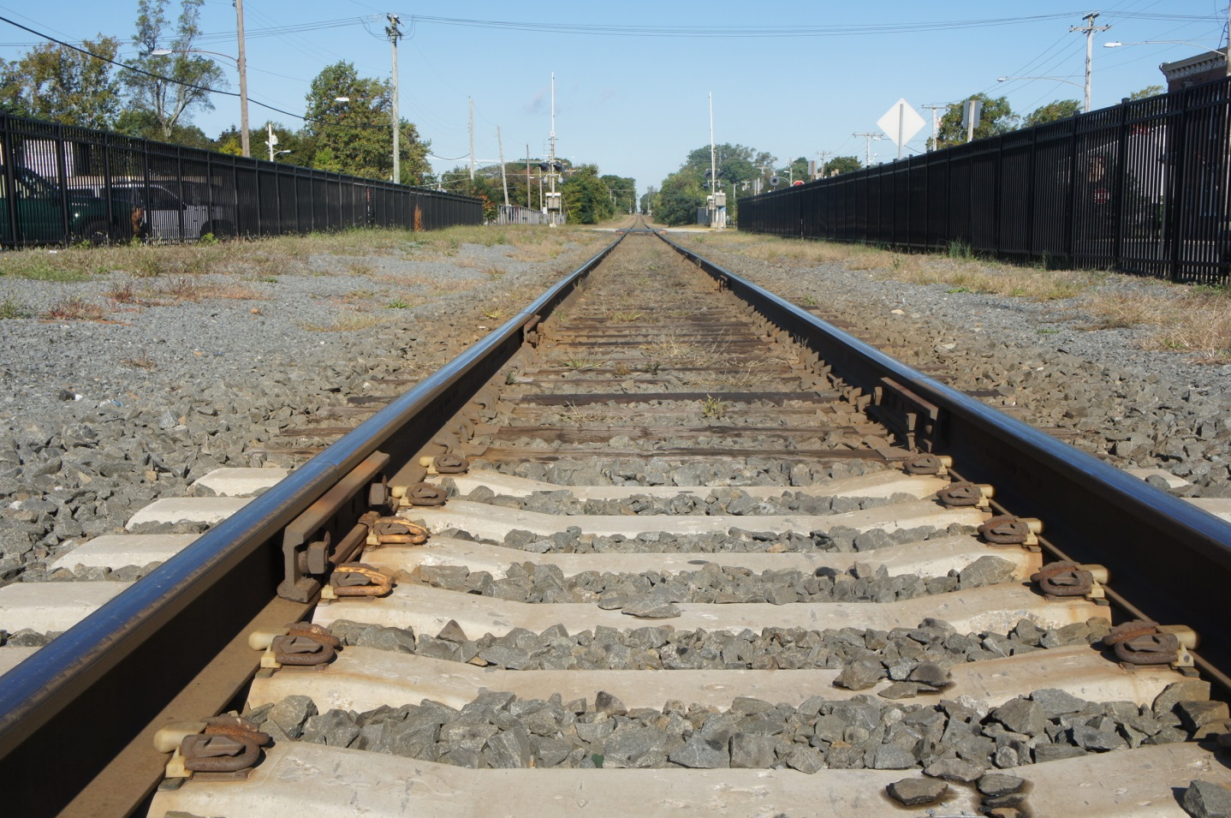
The town is divided by the train tracks and has been around for many years.
West
East

Slide 9
Hammonton and their citizens are the nicest. People are always walking around and shopping. They all know each other too because everyone is so friendly.

Slide 10
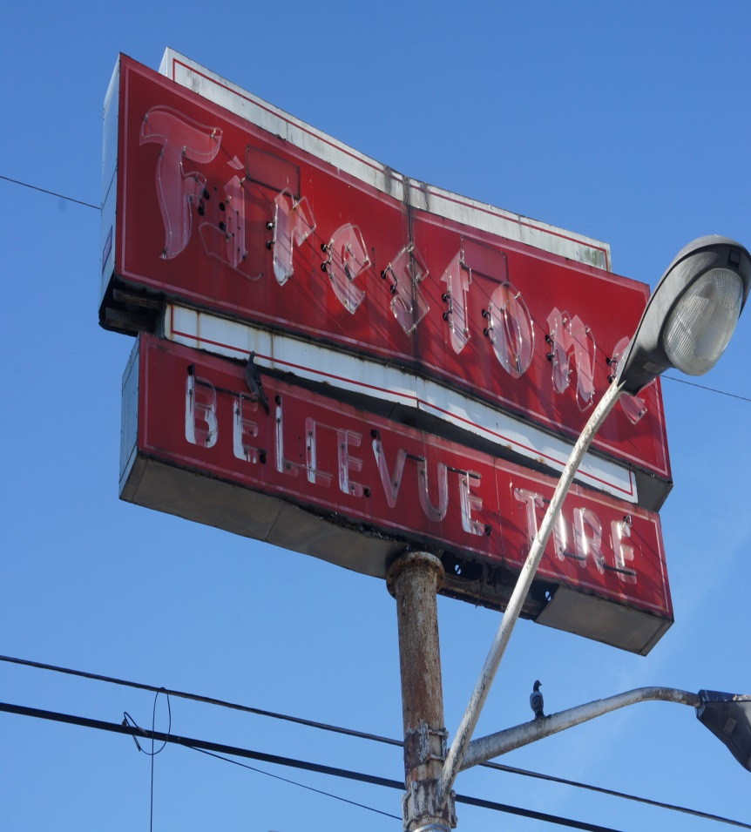
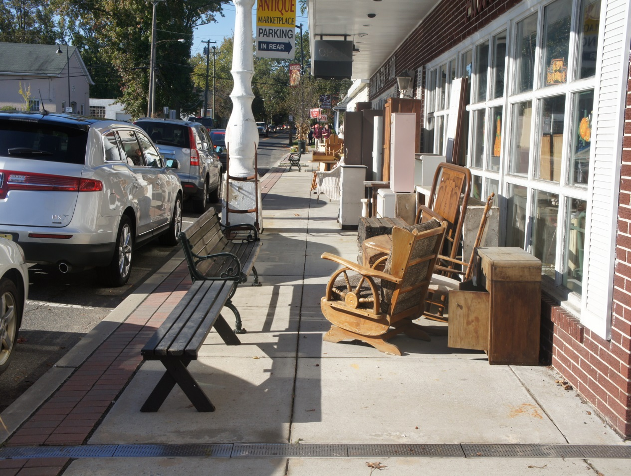
There are many old features of Hammonton that make it interesting. The Firestone car repair shop, the barber shop, and the antique store.

Slide 11
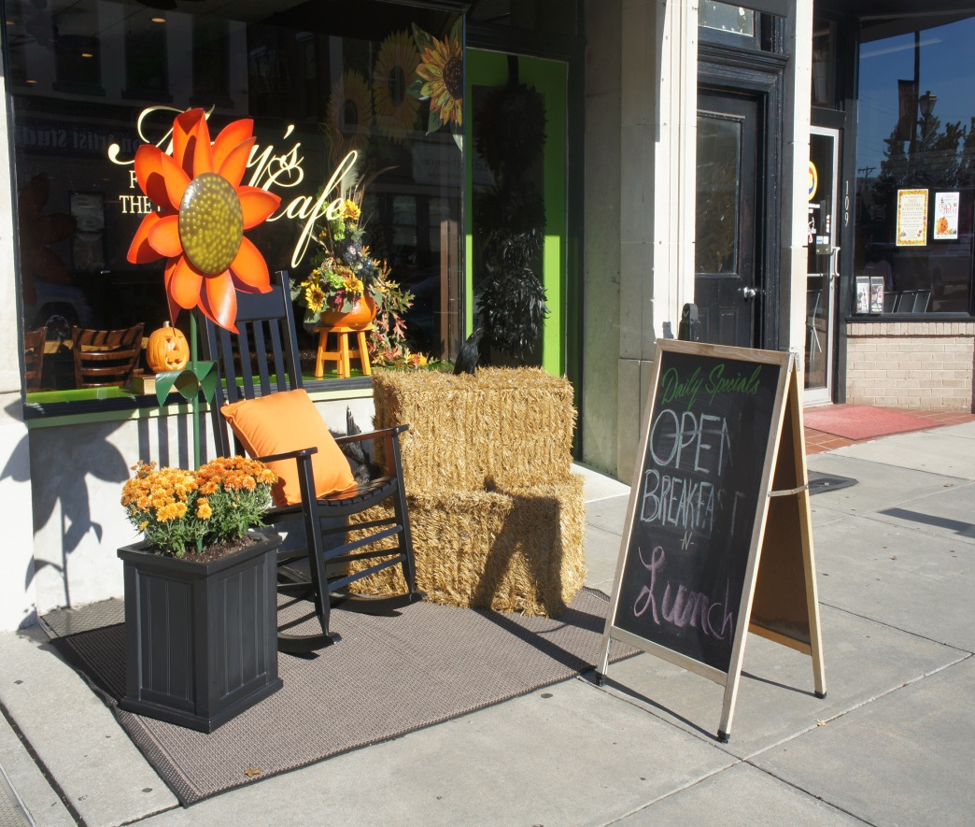
This little town of Hammonton is amazing. I’m glad to be apart of what I can call my second home. When I’m older I'm making sure to bring my kids here to show them what made me the person I am.

